Slide 1


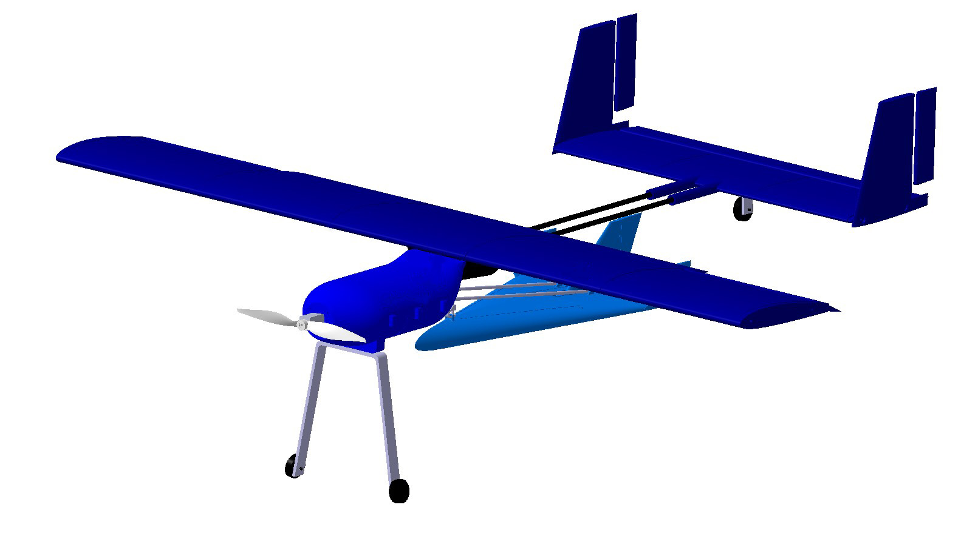

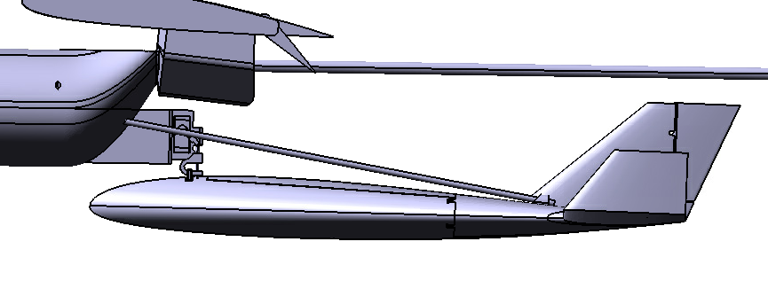
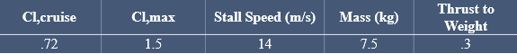


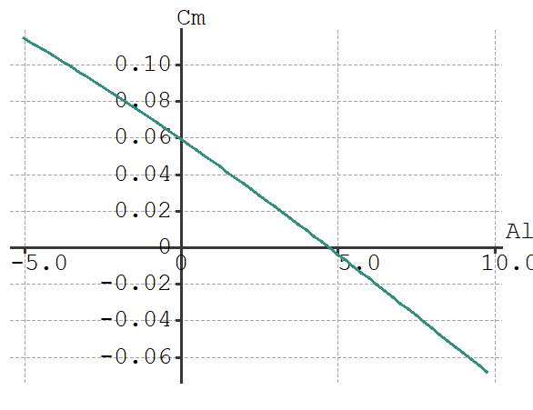
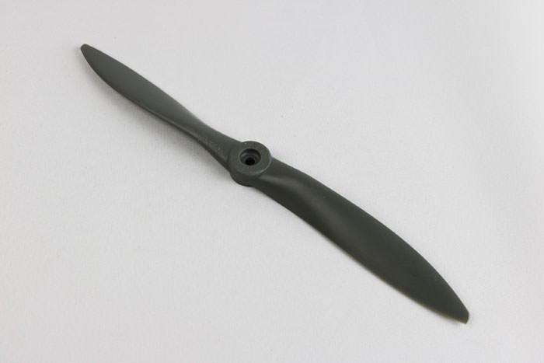
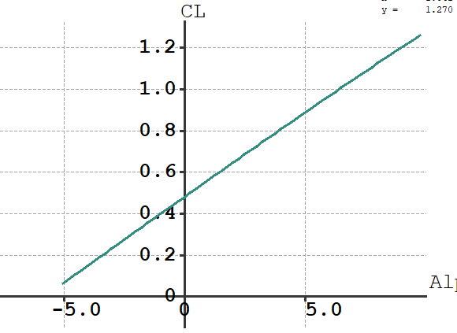
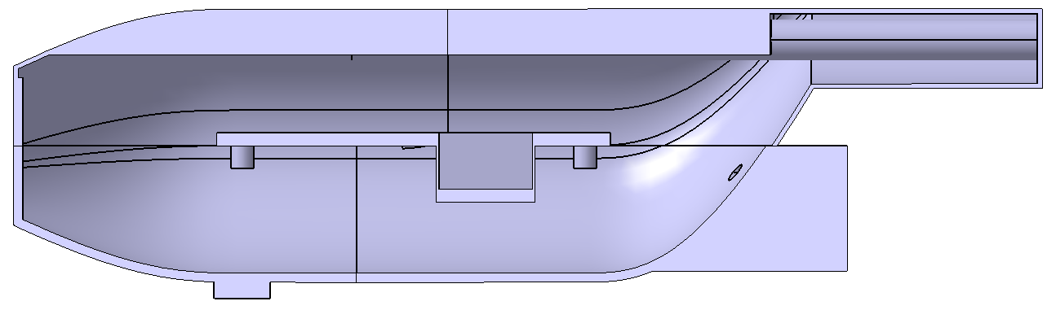
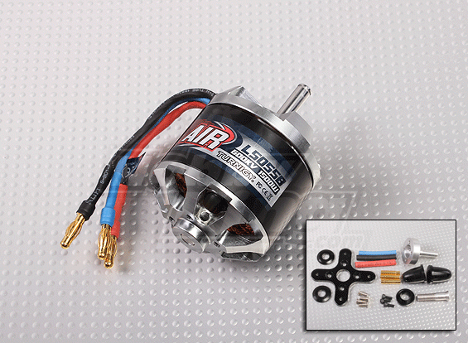
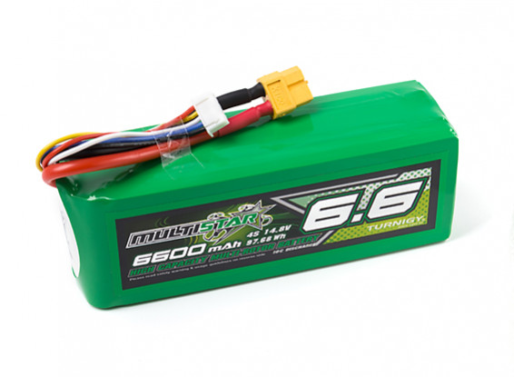
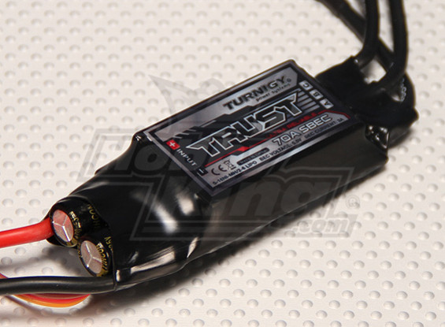
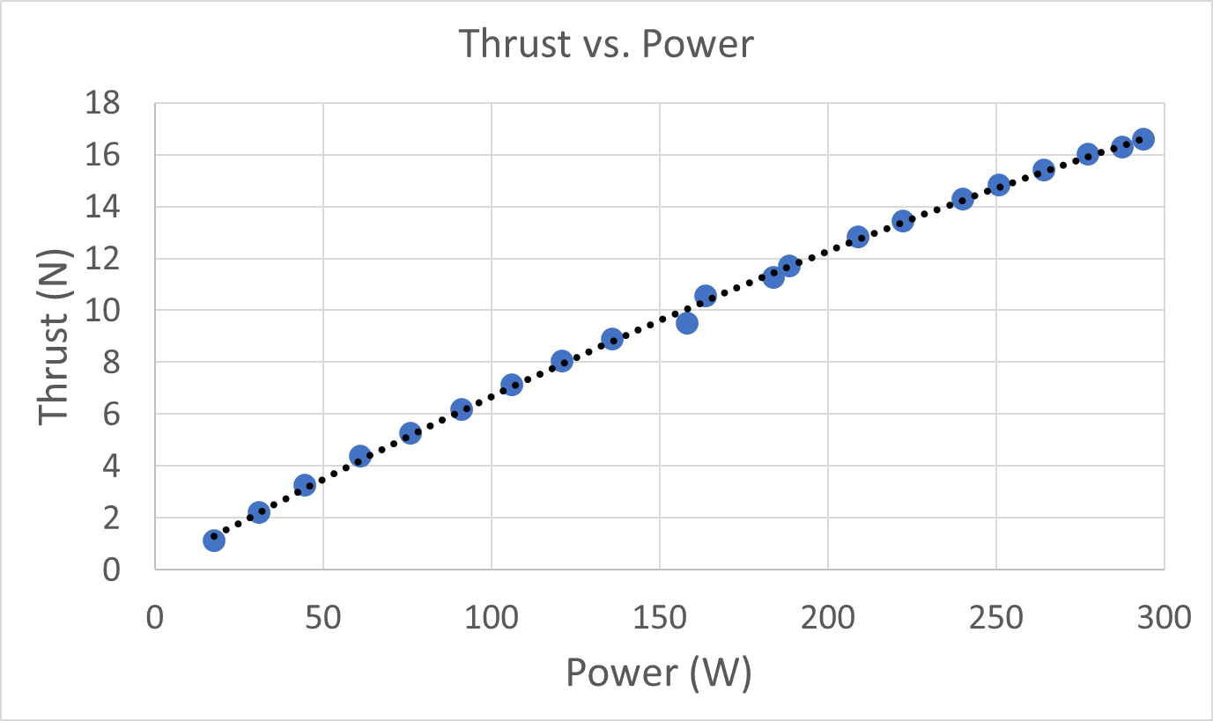
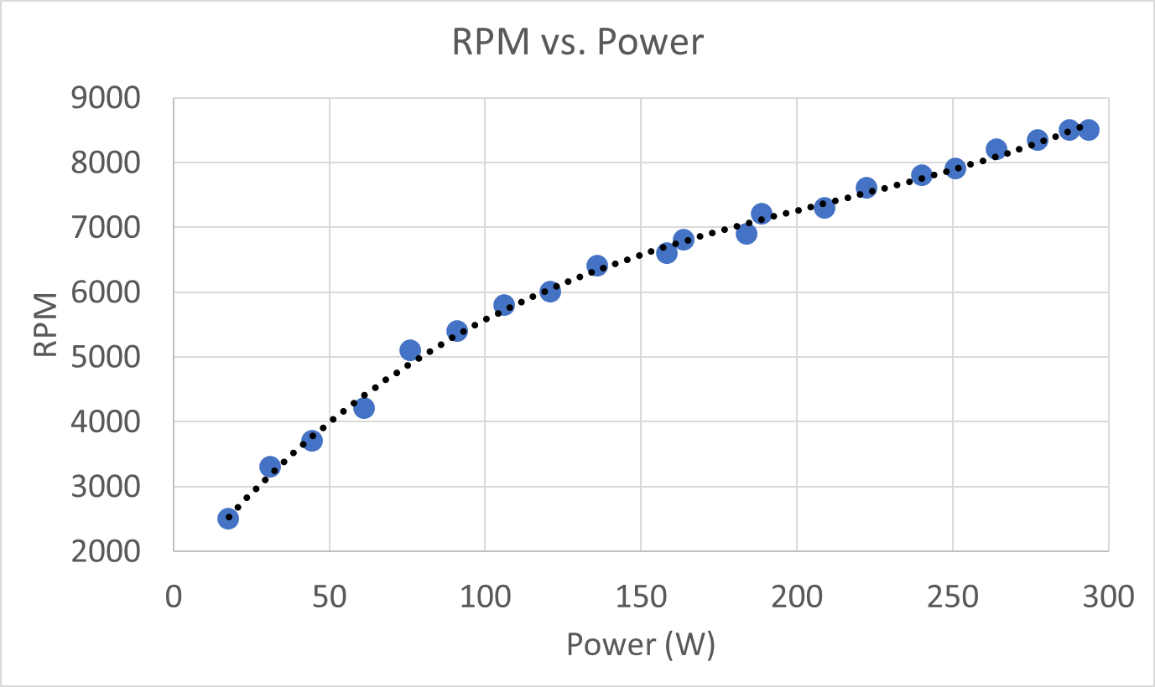
.
Team 7 Mothership
Poseidon
Benjamin Dolin, Elias Ghazal, Bradley Lock, Sarah Rasche, Sean Wan, Veronica Yapriadi
.
Project Objective
Interface Mechanism
As a result from the preliminary design conditions defined by Team 7, the team determined that the glider was to be dropped from the bottom of the mothership. The interface between the two aircraft is of the utmost importance to the mission; the vehicles must not interfere with one another in flight and the glider must be able to fly after being dropped from the mothership.
In order to meet these requirements, a solution was devised that involved a single servo and two angled rods. The servo is driven by the RC receiver which controls the primary control servos using an auxiliary output. The glider is attached to the servo and to the two angled rods using 3-D printed holes in the glider. When the servo opens, the glider slides toward the tail of the aircraft. The glider will fall off of the angled rods after falling off of the servo.
There was much concern that the glider would pitch up and fly toward the aircraft upon release, causing both aircraft to potentially lose stability or structural integrity. Team 7 worked with the glider team to build a test bed and glider to prove the concept. The test was successful and the team obtained video evidence of the glider dropping and pitching down upon release. This test bed is shown in the images below.
Design and build an electric mothership for Sandia National Laboratories that will release a glider that captures the dynamics and constraints of a hypersonic glide vehicle.
Walk Around
The aircraft features a high wing, H-tail configuration with a double carbon fiber rod boom connecting the fuselage and the tail. The glider is placed underneath the booms and connected to the fuselage. The fuselage holds all of the electronics and the motor is attached to the outside of the fuselage. The landing gear is a tail dragger configuration to allow space for the glider.
Fuselage Interior
APC 12x6 Propeller
Wing Design
Motor and Battery
The fuselage is designed modularly with a electronics holding platform that’s removable for easy access. The platform would be holding the ESC and battery. The motor would be mounted in front of the fuselage. The glider release servo is placed in the lower compartment. Six bolts are in place to make the fuselage interior easy accessible.
The Aircraft has the following Cl vs Alpha curve. The airfoil is cambered which is why the curve intersects the Alpha axis at a negative angle of attack. The airfoil is also preset to an angle of attack of 4.5 meaning that the aircraft will need to pitch up smaller amount to climb.
The following graph displays the Cm vs Alpha curve. As one can see, the aircraft is set to naturally correct it’s angle of attack to 4.5 degrees, which is the angle the wings make to the body, meaning the aircraft will naturally tend to flying level. This is makes the aircraft far easier to fly.
ESC: Turnigy Trust 70A SBEC
The main wing is a NACA 2412 airfoil with flaperons that take up roughly 40% of the wingspan. It is divided into fives sections to ensure each piece fits in a 3d printed. The parts are then assembled with two spars running the length of the wing. The tail is an H tail for stability purposes. The tail is a NACA 0010 airfoil.
Static Thrust Test
.

Slide 2
Cl,cruise | Cl,max | Stall Speed (m/s) | Mass (kg) | Thrust to Weight
.72 | 1.5 | 14 | 7.5 | .3

